Slide 1
Cleaner, Greener Labels – Formulating Home Care Products with Robust Preservation
Jonathan Rabiei
Business Development Manager, Emerald Kalama Chemical
15 July 2020
Notes:
We from Emerald have the pleasure to open and close the forum for innovation for homecare this year. As industry leader we not scaring away to take the last presentation slot.
The time has arrived. Announced last year at SEPAWA that Kalaguard SB will be PT6 approved for cleaning products in 2019 and that has happened. This provides a new active substance to the preservation in cleaning since a long time in a even more pressing market need for preservation. Goal of today is to provide some fundamentals of how to formulate with Kalaguard SB

Slide 2


Agenda
Changing trends and drivers for green home care preservation
The need for next-generation, consumer friendly preservatives
Examples of commercial products in the market
Case Studies: Extending preservative efficacy in challenging
home care formulations using Kalaguard® SB
Shifting of the pK_{a} — sodium benzoate synergy with surfactants
Smart formulation choices and taking advantage of pK'_{a} shift

Slide 3




Manufacturer of specialty ingredients optimized to bring performance and value to globally trusted brands for personal care and household care
Consumer Friendly, Effective Benzoate Preservatives
Nature Identical Aroma Chemicals
Performance Enhancing Multifunctionals
Kalama®
Notes:
Specialty chemical producer. We are largest manufacturer for benzoate based preservatives in the world and we hold the finest quality in the world with matters for performance

Slide 4
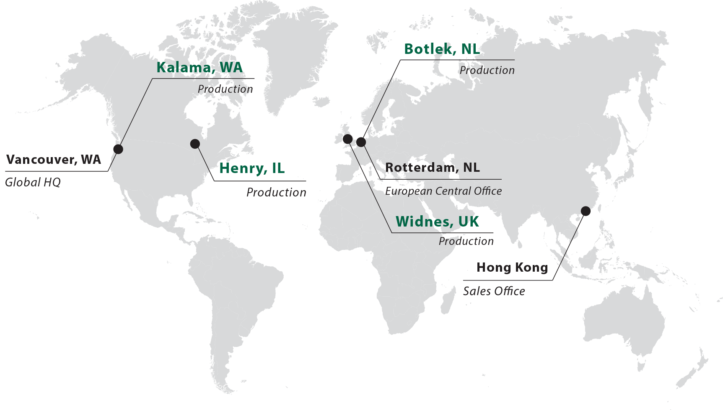
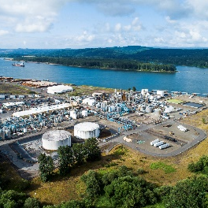
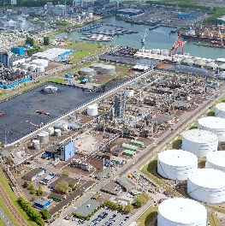
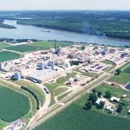


Slide 5
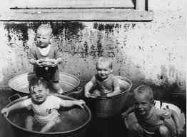
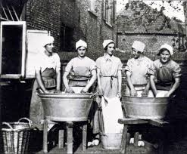
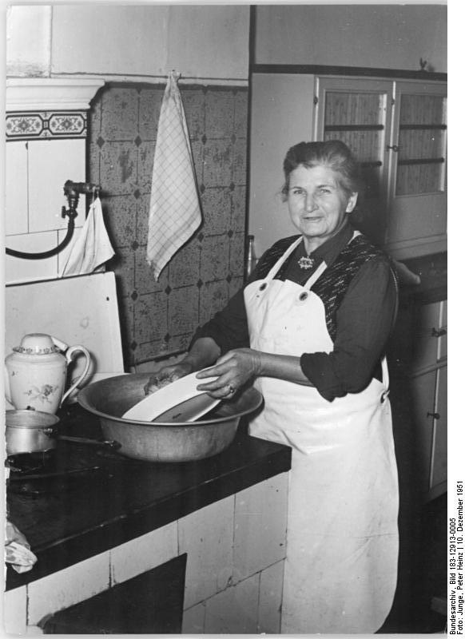
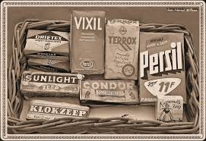
Washing & cleaning – 100 years ago
In 1920
Estimated world population in 1920: 1.7 bio
Average male weekly wage in UK was about £5 (roughly £103 nowadays). A pint cost 75 pence.
Washing and cleaning was a daily job. Most products were solid.
Average life expectancy: 52 years

Slide 6


Today - 2020
In 2020
World population: 7.8 bio. Estimated by the UN to grow to >8.5 bio @2030
Pandemic COVID-19 killing more than 0.5M people ytd
Washing and cleaning is weekly job, with assistance of machines. Most products are liquid
Average life expectation: 73.5 years
  → Our planet’s climate, the ecosystem, and our own human health & safety are under threat
State-of-the-art, modern product design aspects
Function & convenience
Human health impact
Environmental impact
Ecological footprint
Ethical / social aspects

Slide 7






What’s on consumers’ minds?
“How do I know which products reflect my green values?”
“How do I keep myself and my children safe and healthy?”
“How can I help preserve the environment for the future?”
Notes:
What about the future ?
How do I protect my children, keep them safe and healthy?
Climate change and how do we preserve the environment for future generations?
What do I flush down the drain? We are starting to do more than thinking we are going further…

Slide 8
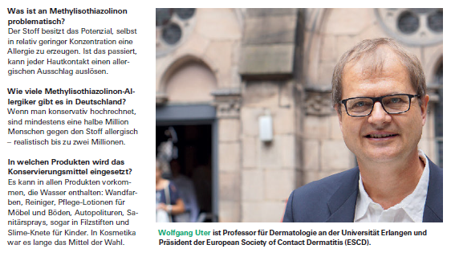
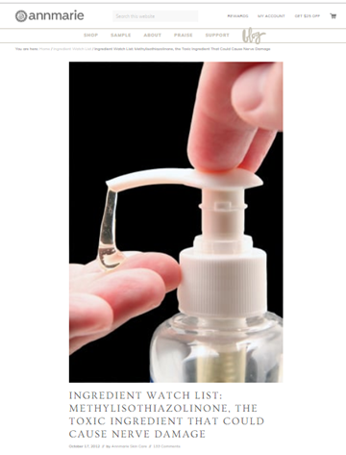

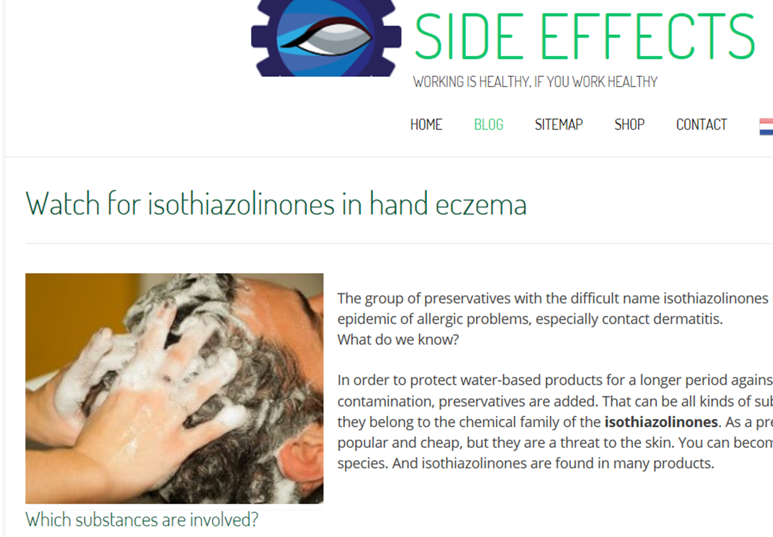
The information pool for today’s consumers
Classical media
“2 Million in Germany estimated to be sensitized by MIT ~ 10% of German households”
Social media – Influencers
Often non scientific based, however with strong effect on consumer behavior
Expert websites & guidelines
Such as websites for NGO’s, advocacy groups
Sources: Stiftung warentest 9/2018, Prof Uter dermatologie Uni Erlangen and chairman European Society of Contact Dermatitis (ESCD), https://www.annmariegianni.com/ (Skin care Blogger), https://bijwerkingenvanwerk.nl/
Notes:
We inform our selves via different channels
+ Classical media
+ Professional websites and advisors
+ Social media by Influencers
… we make up our minds .. Change is necessary ..

Slide 9

What is the hazard to human safety?
Sensitization: Isothiazolinones can cause an allergic reaction even at small concentrations. Once sensitised, each contact produces a reaction.
Replacement of parabens by MIT in personal care
has induced allergic epidemic.
Ban in leave-on products is dropping the rate of new people sensitized. However, many other applications exist with high MIT loading (paints, cleaners, etc.)
Estimation: 0.5 conservative, 2 mio (2.4%) likely persons in Germany are allergic to MIT.
Advice to people already sensitised: avoid products with MIT in all types of products.
Source: Stiftung warentest 9/2018, Prof Uter dermatologie Uni Erlangen and chairman European Society of Contact Dermatitis (ESCD)

Slide 10
Consumer influence of legislative bodies
Consumer and regulatory bodies follow the consumer concerns and sharpen the legislations.
Consumer sensitization to isothazolinones, resulting changes to product labeling requirements
Formaldehyde Donors | Example: | DMDM Hydantoin/Bronopol
Skin Sensitization and Skin/Eye Irritation | Example: | MIT/CMIT, MIT
Active | Skin Sensitizer, H317, specific concentration limit (SCL) | EUH208 required for formulas containing more than:
BIT | 500 ppm | 50 ppm
CMIT/MIT | 15 ppm | 1.5 ppm
MIT | 15 ppm* | 1.5 ppm
Warning: May cause an allergic skin reaction
Contains (name of sensitizing substance).
May produce allergic reaction

Slide 11
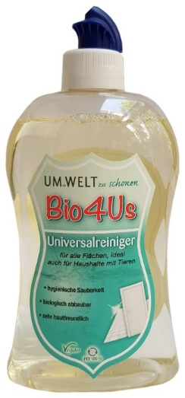
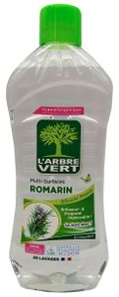
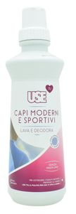
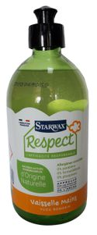

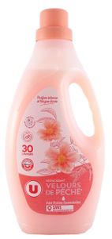
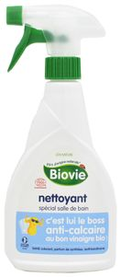
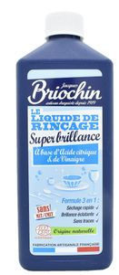
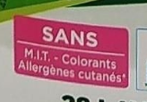
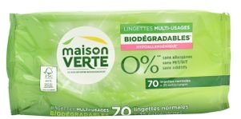


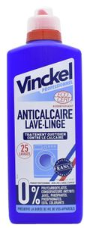
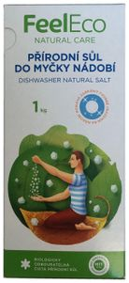
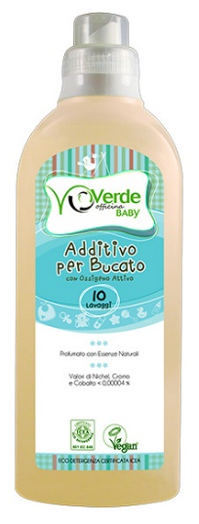
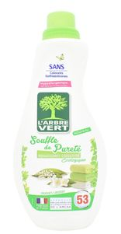
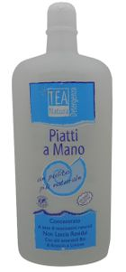

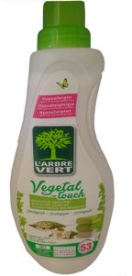
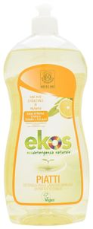

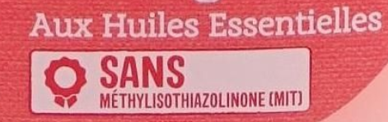
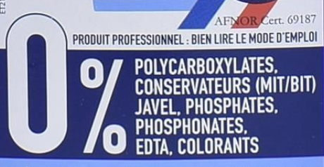
The marketing power of “IT free” labels
Source: Mintel

Slide 12

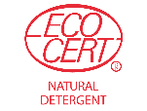
The era of consumer empowerment: green labels
Ecolabel in Europe growing from less than 300 licenses in the year 2005 to more than 2100 licenses granted in 2018, resulting in >72 000 products in the market
Laundry care and cleaning products represent 25% of licenses granted by Ecolabel
Eco brands are expected to grow >10 % AAGR globally
2018
From 31/12/2019, BIT, CMIT & MIT are prohibited in the allowed list of preservatives for detergents by EcoCert!
2005
2010
1996
2000
Nature identical preservatives with low (eco)toxicity & excellent biodegradability, such as sodium benzoate, contribute to ecological profile of cleaning products
Source: Ecolabel website
Notes:
Ecolable revolution – from 1996 with less than 20 licenses to today with more than 2000 licenses
Nordic Swan – 1989 with 12 licenses to today more than 2000 licenses
And we are willing to pay for it!
But we are demanding
We expect governments to follow – and they do – legislation tailored to address the consumer concerns – BPR and labeling requirements
We expect our European companies to act responsible, think sustainable, follow legislation and bottom line act as we do!

Slide 13
Poll: Which green certifications are important to your business?
Ecolabel
Ecocert
EPA Safer Choice / Cleangredients
Other
None – I don’t think green certifications are important

Slide 14
Preservative market trends – personal care
Region
Europe
Category
Beauty and personal care
Personal care industry making the step change and following consumer concerns
Source: Mintel
Notes:
- Do we see the changes as a threat ? No more cheap IT’s ..
Or do we seize the moment and capture the opportunity

Slide 15
Preservative market trends – home care
Region
Germany
Category
Hand Dish Wash
Home care following personal care in preservation trends
Source: Mintel
Notes:
Drill down to applications such as neutral to lower pH? By country? Preservatives in HDW in Germany
- Do we see the changes as a threat ? No more cheap IT’s ..
Or do we seize the moment and capture the opportunity

Slide 16

New active on the market
Sodium benzoate is now available as active substance via the
biocidal product regulation: Kalaguard® SB
The first and only sodium benzoate with BPR PT6 approval – Europe
EPA FIFRA Approval expected end September 2020 - USA

Slide 17




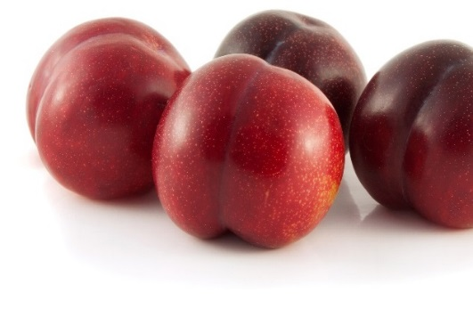
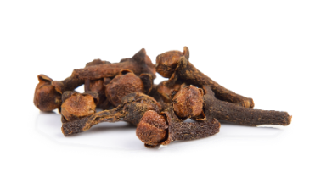
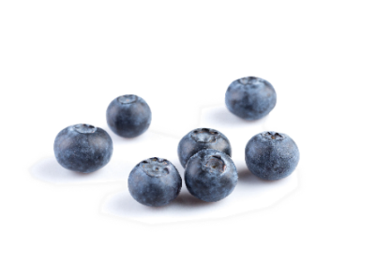
Green Technology Options
Nature identical synthetically produced Kalaguard® SB sodium benzoate
Naturally derived Kalaguard® SB sodium benzoate (directly plant derived)
Certified renewable
ISCC authenticated Kalaguard® SB sodium benzoate from raw materials made from bio-renewable sources
Nature identical
  Benzoic acid is naturally present in many fruits, cloves, cinnamon, and resin.
  Commercially available as synthetic product, but derived from the highest purity benzoic acid available.
  Emerald’s existing products: Kalaguard® SB,
  Purox® S, and Kalama® sodium benzoates
Presence of Benzoic Acid
as a Natural Substance
Wine | 3 ppm
Fruit juices | 4 ppm
Yogurt | 24 ppm
Butter | 8 ppm
Syrups | 4 ppm
Cottage cheese | 32 ppm
Notes:
Safer Choice?

Slide 18

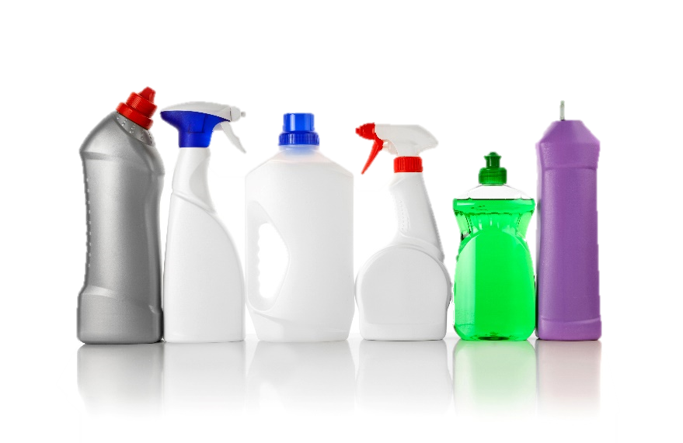



SB
Green, consumer friendly, easy to use
Favorable profile for sustainability
  Nature identical, biodegradable
  Listed for use by Nordic Swan, EU Ecolabel, EPA Safer Choice, other green certifications
Favorable profile for consumers
  Classified as non-irritating to the skin
Favorable profile for manufacturers
  Odorless and non-discoloring
  (cost) Effectively preserves formulations up to pH 7
Key to use in products for:
  Free of isothiazolinones and formaldehyde releasers
  Ecologically friendly
  Skin friendly & sensitive products

Slide 19

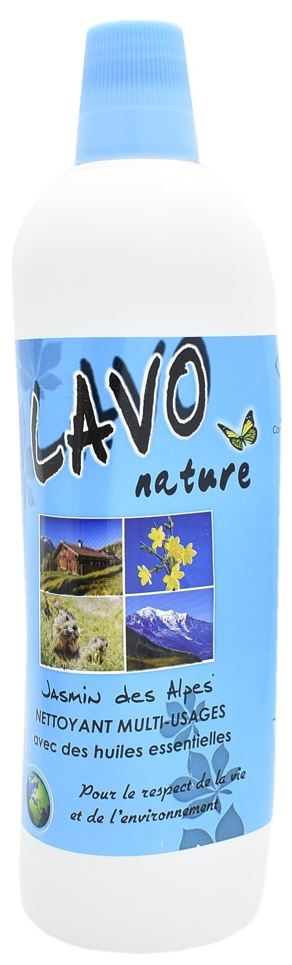
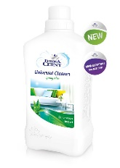
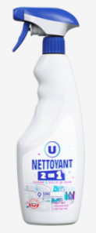
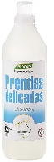
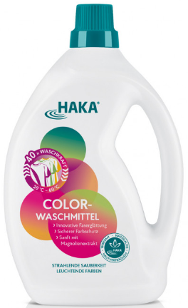
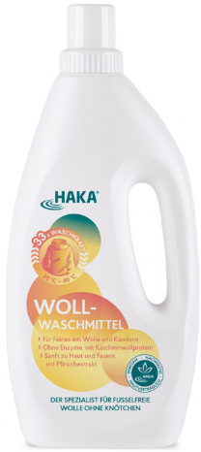
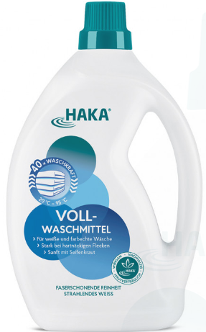
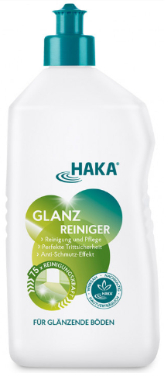
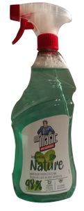
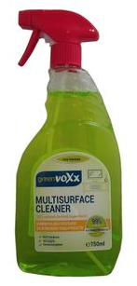
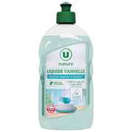
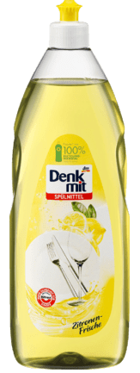

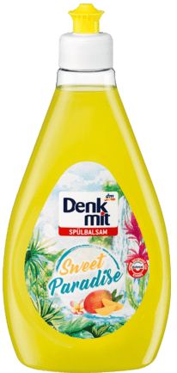

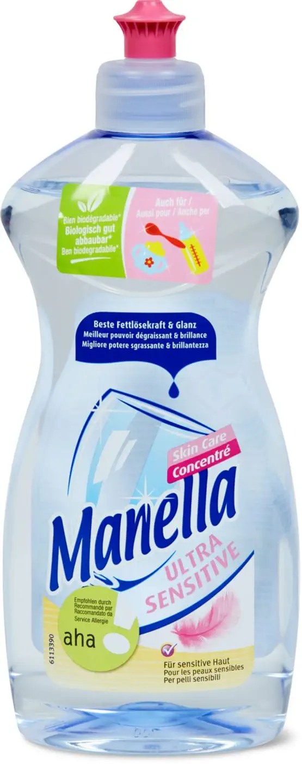
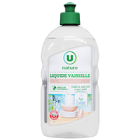
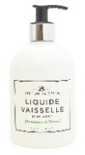


































It has already started!
Preservative solution: Sodium Benzoate
Multipurpose cleaner, Lavo Nature & Eurona Cerny
Bathroom cleaner, Feelco, CZ
Fabric conditioner, Bio D UK, BioCop Spain, Lidl HU
Hand dish wash, Frosch, DE, Super U, FR, L’Arbre Vert, FR
Toilet refresher Block: Tandil, Austria
Surface spray cleaner, Mr. Magic, Poland
Machine descaler: Calgon: FR
Auto dish wash rinse aid: PLUS, NL
Cleaning wipes,
Super U, France
Laundry care, COOP hand laundry liquid
Spot remover: Dr Beckmann, DE
Toilet Gel: Kiilto: FI
Stainless steel cleaner: Edeka: DE
Ceramic glass cleaner: DM: DE
Leather polish: Poliboy, DE
Laundry liquid, Haka DE, Biocop ES
Drain Deblocke:rComptoir des Lys: FR
Connect with us, and our preservatives expert team will support you with your formulation needs.
Source: Mintel – Home care market Europe – 2019/20; shop information

Slide 20
Poll: Other than efficacy, what are your main priorities for preservation?
Meeting criteria for eco-friendly products and certifications
Regulatory / label considerations
Eliminating skin sensitization / irritation
Cost
Supply / availability

Slide 21

Market example formula: Lidl fabric conditioner
Water (aqua)
5-15% Fatty acids, C10-20 and C16-18-unsatd., reaction products with triethanolamine, di-Me sulfate-quaternized
<5% isopropyl alcohol
Fragrances (coumarin, hexyl cinnamal, linalool)
Kalaguard® SB sodium benzoate
Source: Mintel, Lidl website

Slide 22


Model formula: fabric conditioner, pH 3.0
Ingredient | Purpose | Wt, %
Water | Carrier | Q.S.
Kalaguard® SB sodium benzoate | Preservative | 0.1
Methyl bis[ethyl (tallowate)] -2- hydroxyethyl ammonium methyl sulfate | Cationic Surfactant | 5.0
Phosphoric Acid | pH adjuster | to pH 3

Slide 23


Preservation efficacy evaluation method: fabric conditioner
PCPC M3 Method
Double inoculation, initial & 7 days
Bacteria
Escherichia coli Staphylococcus aureus Pseudomonas aeruginosa Burkholderia cepacia Acetobacter aceti
Fungi
Candida albicans Aspergillus brasiliensis
Third party lab used for testing
Notes:
Full PCPC method has measurement and inoculation at 14 and 28 days. (This method recommended by Doug at Rockline to get 7-day window.) The microbes were also grouped by type rather than evaluated by individual log reduction.
Methodology chosen due to environmental isolates - need for more challenging test conditions, better negative controls

Slide 24
Fabric conditioner preservation, pH 3.0
CFU
(Colony Forming Units)
Days
Days
The negative control showed growth of B. cepacia (bacteria) and A. brasiliensis (mold)
which were effectively controlled with Kalaguard® SB at 0.1%.
Notes:
Key takeaway - negative control showed growth with mold and B Cepacia. B. capecia does not pass. Mold was uncontrolled at all test points (“continues to hang around”).

Slide 25

Market example formula: Action hand dish wash
Water (aqua)
5-15% Sodium laureth Sulfate
<5% Cocamidopropylbetaine
Sodium chloride
Citric acid
Parfume
Kalaguard® SB sodium benzoate
Moved away from BIT/MIT
Source: Mintel, Action website

Slide 26


Model formula: hand dish wash, pH 4.5
Ingredient | Purpose | Wt, %
Phase A
Water | Carrier | Q.S.
Sodium Laureth Sulfate | Surfactant | 12.0
Sodium Coco Fatty Alcohol Sulfate | Surfactant | 3.0
Lauryl / Myristyl Glucoside | Surfactant | 4.0
Phase B
Kalaguard® SB Sodium Benzoate | Preservative | 0.5
Sodium Chloride | Viscosity Builder | 1.0
Phase C
Citric Acid | pH Adjuster | to pH 4.5

Slide 27
Preservation efficacy evaluation method: hand dish wash
European Pharmacopeia (EP) Method
Single inoculation
Bacteria
Escherichia coli* Staphylococcus aureus Pseudomonas aeruginosa
Fungi
Candida albicans Aspergillus brasiliensis
* Not required under EP
Third party lab used for testing
Notes:
Full PCPC method has measurement and inoculation at 14 and 28 days. (This method recommended by Doug at Rockline to get 7-day window.) The microbes were also grouped by type rather than evaluated by individual log reduction.
Methodology chosen due to environmental isolates - need for more challenging test conditions, better negative controls

Slide 28

Optimizing cost and skin friendly attributes with hand dish wash preservation, pH 4.5
Skin’s natural pH is 4.2—5.9 when healthy. As a result, products with a slightly acidic pH are considered more skin friendly as they may pose less potential for irritation than neutral/alkaline formulations.*
Kalaguard® SB sodium benzoate is effective in the skin-friendly pH range.
Lowering pH is a cost-effective solution to maximize the antimicrobial efficiency of Kalaguard SB.
* Sources: M.-H. Schmid-Wendtner and H.C. Korting. The pH of the Skin Surface and Its Impact on the Barrier Function. Skin Pharmacol Physiol 2006;19:296–302. https://epub.ub.uni-muenchen.de/16348/1/10_1159_000094670.pdf.
H Lambers et al. Natural Skin Surface pH Is on Average Below 5, Which Is Beneficial for Its Resident Flora. Int J Cosmet Sci. 2006 Oct;28(5):359-70. https://onlinelibrary.wiley.com/doi/abs/10.1111/j.1467-2494.2006.00344.x.

Slide 29

Shifting formulations in your favor
Lower pH of product to skin friendly level.
Common boosters, such as chelators and multifunctional ingredients, can extend the efficacious pH range of
sodium benzoate.
Choice and concentration of surfactants can increase concentration of benzoic acid (enhancing preservation efficacy). pK'_{a} of benzoic acid is formulation dependent.
Sodium benzoate can be an effective preservative even
at higher than traditional pH range.
Green formulations can present unique challenges for preservation, such as higher water activity,
label considerations, and higher use of biorenewable ingredients. Strategic formulation choices can optimize antimicrobial efficacy in consumer friendly products that meet today’s needs.
Notes:
Preservation is no longer an afterthought. To meet today’s needs for consumer friendly products that are effectively preserved, the whole formula must be considered up front – pKa, pH, water activity, ingredient interactions, osmality, etc.

Slide 30
Lower pH: hand dish wash liquid
■ E. Coli  S. aureus  P. aeruginosa  C. albicans  A. brasiliensis
Kalaguard® SB is effective in the skin-friendly pH range.
Lowering pH is a cost-effective solution to maximize the antimicrobial efficiency of Kalaguard® SB.

Slide 31
Add a multifunctional: eco-friendly chelator (GLDA)
Tetrasodium Glutamate Diacetate (GLDA) is readily biodegradable, has wide pH range, and is considered non-irritating to the skin and eyes, making it a good choice for green formulations with sodium benzoate
1.5% Kalaguard SB, pH 6.5
1% Kalaguard SB, 0.5% GLDA, pH 6.5
Chelators contribute to cleaning and foaming of products while also enhancing the preservation of Kalaguard® SB

Slide 32
Add a multifunctional: Emerald® X7
Emerald® X7 is a new multifunctional, which is biodegradable, nature identical, non-sensitizing,
low toxicity, and effective over a very wide pH range.
Emerald® X7 aids in formula processing, solubilizing ingredients, and loosening fatty soils.
When paired with Kalaguard® SB, sodium benzoate provides more robust preservation.

Slide 33
Choice and concentration of surfactants: increase concentration of benzoic acid (enhancing preservation efficacy)
Six-fold increase
Eight-fold increase
Antimicrobial active
Notes:
Theoretical calcuations using HH Equation. Includes NMR data and cosurfactant with CAPB.
At ph 5.5, benzoic acid concentration increases: 6x with introduction of 10% SLS and 8x with introduction of 10% SLS + 3% CAPB.
Data supports conclusion: outside micelle, there can only be so much benzoic/Nab. We get higher concentration b/c benzoic acid leaves water phase and goes into micelles – can diffuse out if equilibrium shifts. Tails of micelles are molecule activated?
Clarification: Nonionic surfactants can inactivate certain preservatives. However, this data does not indicate that the benzoic acid is deactivated b/c it can defuse back out. We have data to support that it is not deactivated.

Slide 34

Applying pK'_{a} shift: formulation dependent
1
2
3
pH | 6.0 | 6.0 | 6.0
SLS % | 4% | 10% | 10%
Co-surfactant | - | - | 3% CAPB
Benzoic pK’_{a} estimate | 4.5 | 5.1 | 5.3
Kalaguard® SB Recommendation | 1.2% | 1.0% | 0.9%
Notes:
For three different customer examples, we can consider the formula pH, surfactant type and concentration to make tailored recommendation using our data and models.

Slide 35





Typical dosage to start experiments
0,1%
0,4%
0,7%
1,2%
1,8%
pH
3
4
5
6
7
Source: Mintel 2019 – 2020 – The shown products are visualized in the above pH range – Recommended Kalaguard® SB levels are to be considered for guidance only and do not represent content levels in the shown products.
Notes:
Starting point in formulations – fine tuning recommendations based on pKa research

Slide 36


Conclusions
Label transparency for ingredients in home cleaning products is on the rise.
The preservatives
palette is shrinking.
Consumers are paying more attention
to what is in their products.
Kalaguard® SB was shown to be an effective new preservative for home care, providing formulators with a green, consumer friendly, non-irritating option for preserving formulations.

Slide 37
Disclaimer
The information contained herein is believed to be reliable, however is based upon laboratory work with small scale equipment and does not necessarily indicate end-product performance. Because of variations in methods, conditions and equipment used commercially in processing these materials, Emerald makes no representations, warranties or guarantees, express or implied, as to the suitability of the products for particular applications, including those disclosed, or the results to be obtained. Full-scale testing and end-product performance are the responsibility of the user. Emerald Performance Materials shall not be liable for and the customer assumes all risk and liability for use and handling of any materials beyond Emerald’s direct control. Nothing contained herein is to be considered as permission, recommendation nor as inducement to practice any patented invention without permission of the patent owner.

Slide 38
Jonathan Rabiei
Business Development manager, Emerald Kalama Chemical
kalaguard@emeraldmaterials.com
‘Use preservatives for products during storage safely. Always read the label and product information before use.’

Slide 39
Poll: What are the biggest preservative trends that you’d like to learn more about?
Contrasting existing antimicrobial actives
Additional multifunctional solutions
Biorenewable preservative solutions
Formulating for sensitive skin

