Slide 1
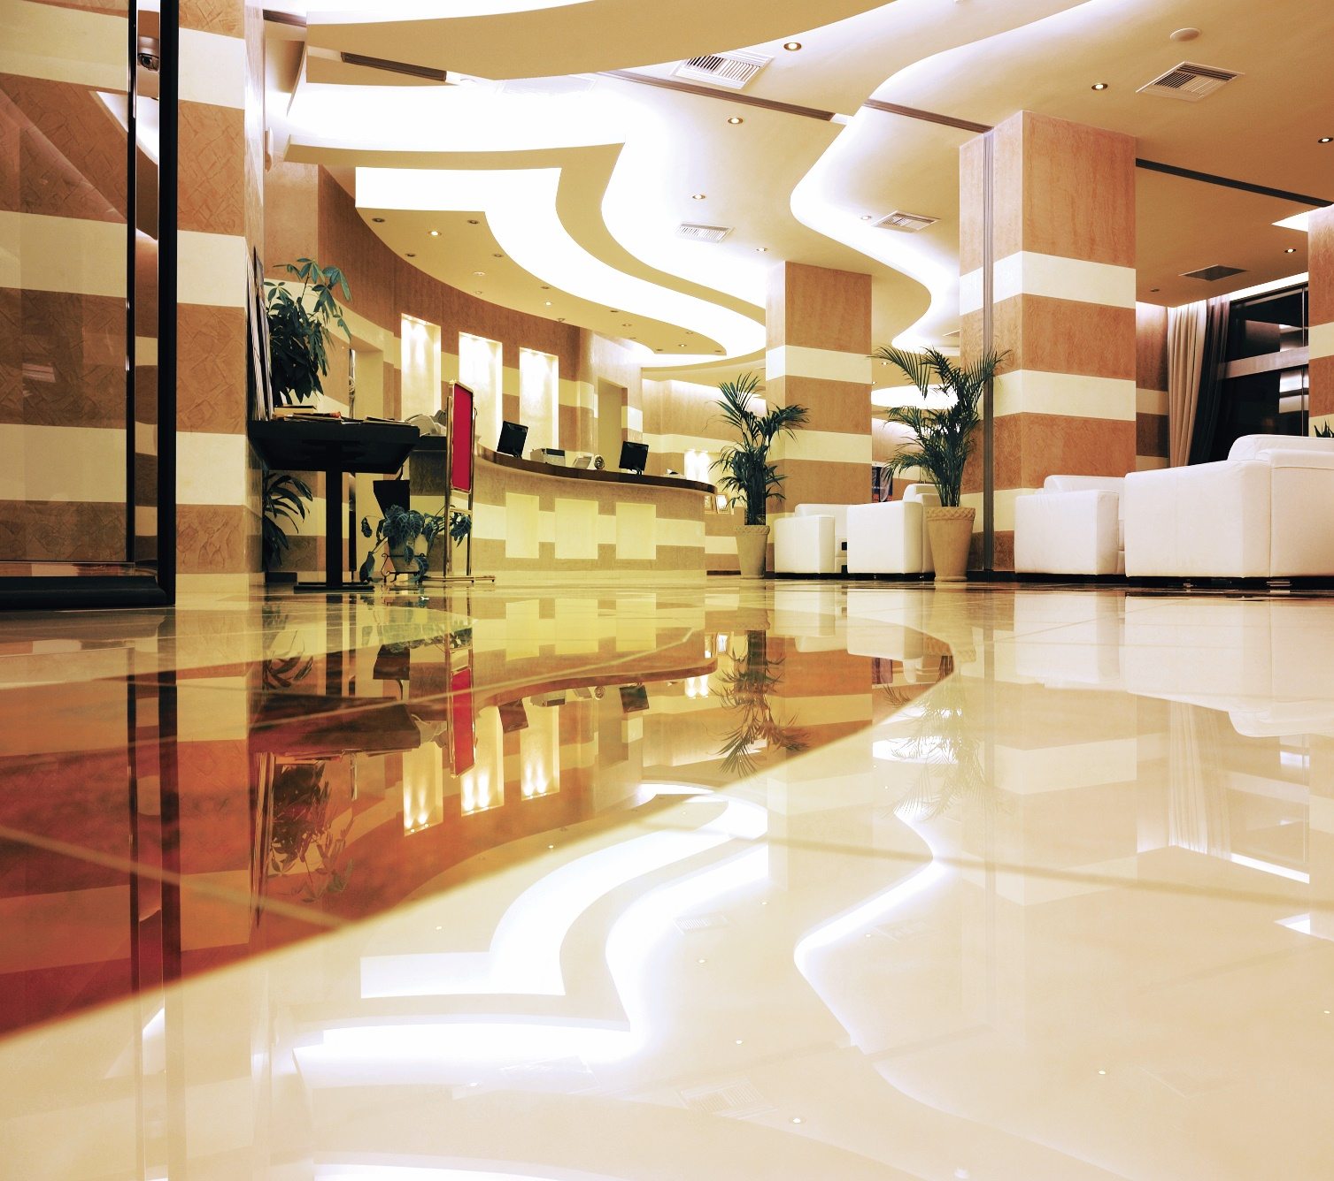
The Advantage of Evonik’s Innovative Polycarbamide Technology for One-Day Flooring Systems
Shafiq Fazel
June 10, 2020

Slide 2
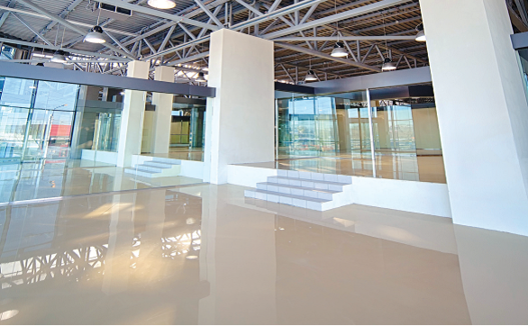
Agenda
Resinous/Seamless Flooring Systems
  Purpose
  Key Market Trends
Polycarbamide Technology for Flooring Applications
Amicure IC® Curing Agents
  IC-221, IC-321 & IC-322
Epoxy and Polycarbamide Synergy
One day flooring system examples
Summary

Slide 3
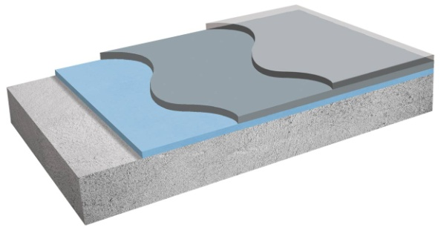
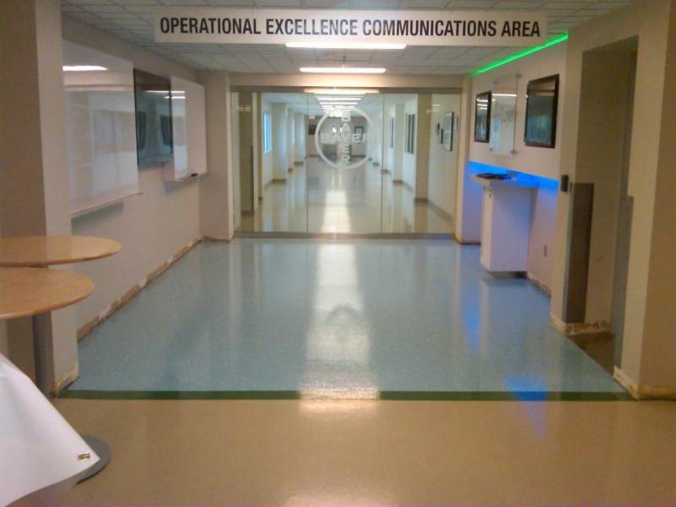
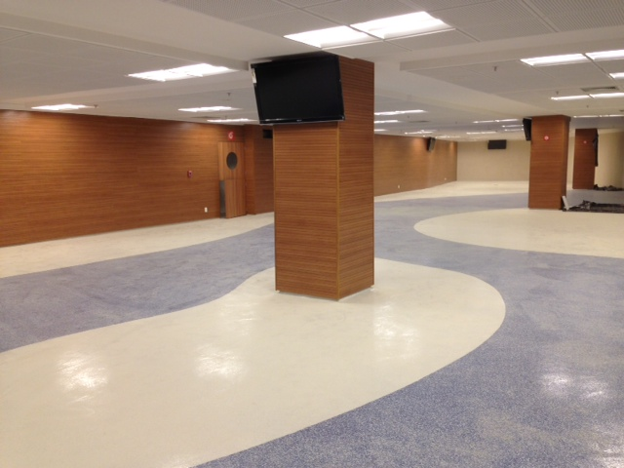
Resinous/Seamless Flooring Systems over Concrete
General purpose for resinous concrete flooring system
Concrete protection against mechanical and chemical impact
Protection from concrete influence (dust, pores, cracks)
Homogenous, easy to clean and tight surface (hygiene)
Safety (no unevenness, hidden traps, proper marking of areas for different use – walkways, storage and working areas)
Specific functional properties (chemical resistance, non-yellowing, abrasion resistance)
Endless choices in the design (aesthetics)
C
B
A
Functional layers
Primer
  Good adhesion to concrete
  Good inter-coat adhesion
Mid-Coat (ex. self-leveler, trowelable)
  High strength and dimensional stability
  Improved load bearing
Topcoat
  UV resistance
  Chemical and wear resistance
Notes:
Proper concrete floor systems provide many benefits including safety, durability, easy maintenance, great flexibility in design

Slide 4
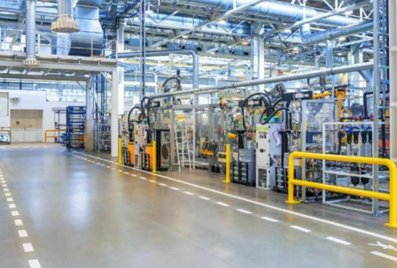


Key Market Trends in Flooring Industry
Enhanced Product Performance
Better
Aesthetics
Chemical, abrasion, impact
Better UV stability
Faster
Fast cure speed
Low temperature cure
Robust application
Productivity Improvement
Fast Return to Service
Safer
Low to zero VOC
Low Emissions
Improved worker safety
Low odor
Environmentally and User Friendly

Slide 5
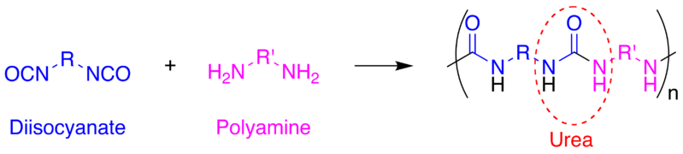
Polycarbamide Technology Helps to Meet Flooring Market Needs
  Provide a unique combination of UV stability, ultrafast return to service, low temperature cure, high abrasion and chemical resistance, and varying finish
  Polycarbamide is “an amine cured polyisocyanate resulting in 2 amines joined together by a carbonyl functional group …” (Similar to polyaspartic or aliphatic polyurea)
+
Polyisocyanate resin
Amine curing agent
Polycarbamide
Polyisocyanate*
*Various commercial suppliers
Amicure ® IC
Notes:
By definition a polycarbamide is an amine cured by an isocyanate. This results in 2 amines joined together by a carbonyl. The polycarbamide technology is different from a polyurea in that they are designed to be conventionally applied as opposed to plural component sprayed. Also the polycarbamides will give rise to UV resistant coatings with fast return to service.

Slide 6
Evonik Polycarbamide Products: Amicure® IC Curing Agents
 | Amicure® IC-221 | Amicure® IC-321 | Amicure® IC-322
Curing Agent properties | Fast cure at low temperature and low humidity conditions | Slower cure formulation with longer working time, better for higher temperature and humidity | Similar in speed to IC-321; adds the ability to customize sheen
Color (Gardner) | <1 | <1 | <1
Amine Equivalent weight | 376 | 379 | 379
Viscosity (cP, 25ºC) | 350 | 225 | 100
VOC (g/L, as supplied) | 0 | 0 | <100
Handling/Performance Properties (Used with Standard Polyisocyanate)
Mix Viscosity (cP, 25ºC) | 1300 | 1000 | 425
Viscosity build (minutes to 12,000 cP) | 22 | 55 | 70
Thin film set time (22ºC) - hrs | 2 | 6 | 6
Shore D hardness | >70 | >70 | n/a
Gardner impact (in.lbs) Direct/Reverse | >160 / >160 | >160 / >160 | >160 / >160
Taber abrasion (mg loss) 1000cycles,CS17 | 42 | 40 | 50
Elongation at break (%) | 10 | 25 | n/a
QUV-A (500hrs) – Delta E | 4.4 | 2.2 | 3.5

Slide 7
Amicure® IC Typical Properties vs. Other Light Stable Technologies
Market Trends | Amicure® IC | Standard Polyaspartic | 2K aliphatic solvent-borne polyurethane | Methyl meth-acrylate
Enhanced Performance
Aesthetics (Modify gloss) |  | Only high gloss |  | Only low gloss
Abrasion Resistance
Chemical resistance |  |  |  | Poor organic solvents
Impact resistance/flexibility
Productivity
Fast return to service |  |  | Slow cure
Low temp cure
Handling/user friendly | Humidity effect | Humidity effect |  | Short pot-life
Thick film in one pass
Environmentally Friendly
VOC |  | VOC exempt solvents | Solvents
Odor |  | Solvents |  | Strong odor
Good
Medium
Low

Slide 8
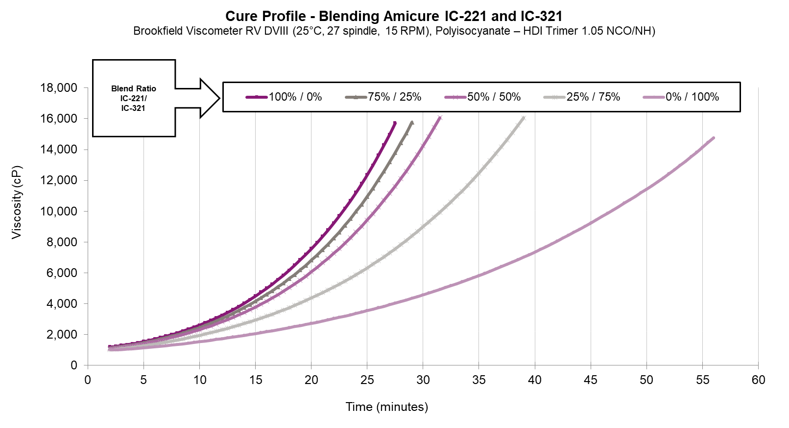
Starting Formulation: Amicure® IC-221, 321 and IC-322
Clear topcoat
Amicure® IC-221, IC-321 and IC-322 “Clear Coat” Starting Point Formulation
Part A | Parts by Weight | Supplier
HDI Trimer Isocyanate (21.8wt% NCO) | 100 | Various
Part B
Amicure IC-221, IC-321 or IC-322 | 187 | Evonik
Tinuvin 292/1130 (1:1) | 2.0 | BASF
Air Release Agent* | 2.0
* See recommendation in the formulating guide. The use of an air release agent should be tested for recoatability & film clarity especially in thicker films.
Typical Properties:
Amicure® IC-221, IC-321 and IC-322 are fully compatible and can be combined in the formulation to modify reactivity
Water Spot Testing (ASTM D1308)
Amicure IC-221 – resistance after 2 hrs cure time
Amicure IC-321/322 – resistance after 4 hrs cure time Accelerated weathering-2,000hrs QUV-A (ASTM G154) ∆E <5 Gloss Retention >95%

Slide 9
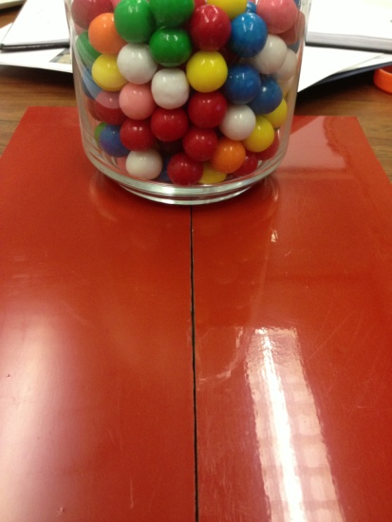
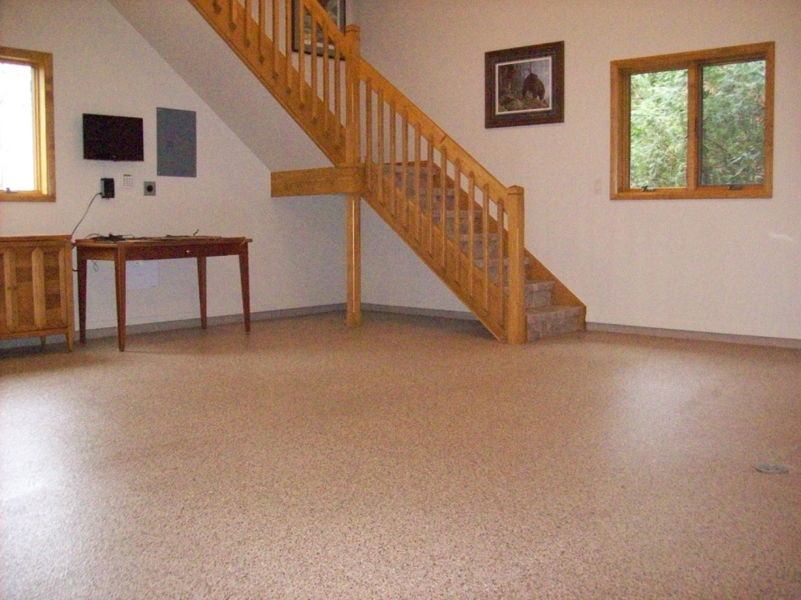
Starting Formulation: Amicure® IC-322
Satin topcoat
Amicure® IC-322 Topcoat for Flooring Application Satin Starting Point Formulation
Part A | Parts by Weight | Supplier
HDI Trimer Isocyanate (21.8wt% NCO) | 100 | Various
Part B
Amicure® IC-322 | 187 | Evonik
Tinuvin 292/1130 (1:1) | 2.0 | BASF
Dispersant* | 2.0 - 4.0 | Byk Chemie
Air Release Agent* | 2.0 – 3.0
Molecular Sieve A3 | 2.0 - 4.0
Acematt® 3600 | 28 - 36 | Evonik
* See recommendation in the formulating guide. The use of an air release agent should be tested for recoatability & film clarity especially in thicker films.
High Gloss
Thickness (mils) One pass | Gloss (60º)
5 | 35
10 | 38
20 | 37
Satin
Satin (with matting agent); High Gloss (without matting agent)
^{60º Gloss}

Slide 10
Flexibility to Change Handling Properties with Blends of IC-221 and IC-321

Slide 11
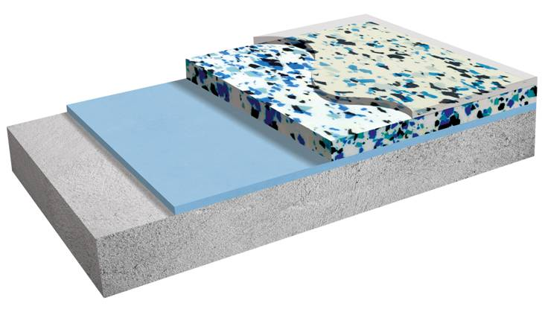
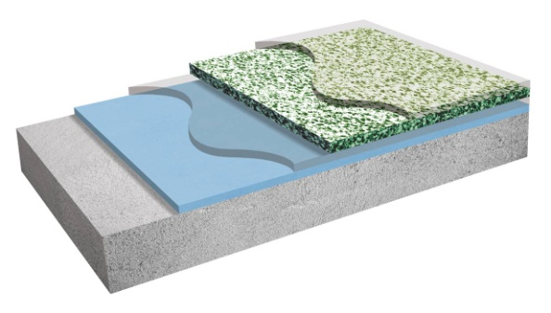
Various Flooring Systems
Excellent Synergy with Epoxy Technology
Thin Film Coatings Systems (< 20 mils)
Thick Build Self-Leveling Resurfacer Systems (~ ¼”)
Broadcast Flooring Systems (20 – 60 mils)
B
C
C
C
A
B
B
A
A
Functional layers
Primer (Epoxy) B. Mid-Coat (Epoxy or Polycarbamide) C. Topcoat (Polycarbamide)
When used together in industrial, commercial & institutional flooring applications, combined epoxy and polycarbamide coatings provide a unique combination of high performance & rapid return to service
Combined Epoxy & Polycarbamide coatings deliver:
Moisture tolerance and strong physical properties
Excellent adhesion to concrete (damp & green)
Rapid return to service
Customizable sheen with UV stability
High abrasion and impact resistance
Better cost control

Slide 12
Polycarbamide and Epoxy Curing Agents Recommendations
 | Thin Floor Coating | Self Leveling Flooring | Broadcast Flooring
Primer | Anquamine® 287 | Anquamine® 287 | Anquamine® 287
 |  | Ancamine® 2850 | Ancamine® 2850
Mid-coat | Ancamine® 2735 | Urethane cement | Ancamine® 2735
 | Anquamine® 401/Ancarez® AR555 | Epoxy Modified Cement (Anquamine® 287/Ancarez® AR 462) | Amicure® IC-221/321
Top-coat | Amicure® IC-221 (Low temp, Low humidity, fast cure)
 | Amicure® IC-321 (High temp, high humidity, slow cure)
 | Amicure® IC-322 (High temp, high humidity, slow cure, low gloss finish)
r
✓
Better
Water based Epoxy Coating
Solvent Free Epoxy Coating
✓
Safer
✓
Faster

Slide 13
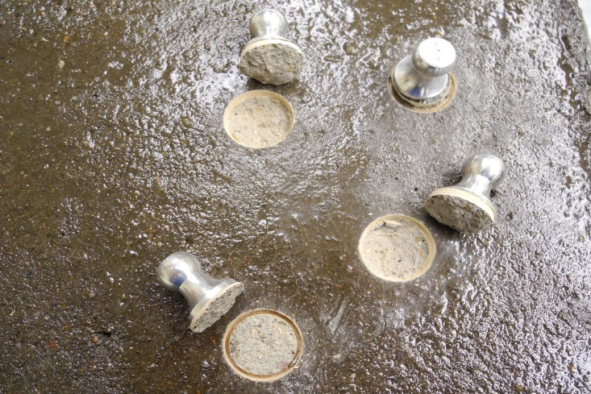
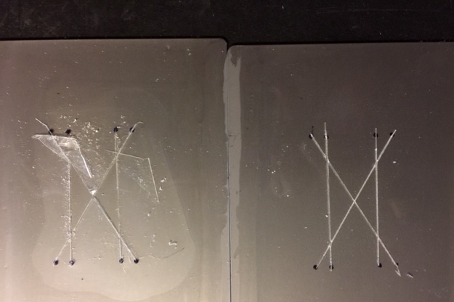
Intercoat Adhesion is Critical to Select the Best Flooring System
Standard Lab testing to determine Intercoat Adhesion
Our data for system recommendations are derived largely from neat resin clear formulations
Fillers, pigments, additives, surfactants, dispersing agents, and environmental conditions can all impact the recoatability and inter-coat adhesion of a system
Dolley Pull Adhesion (ASTM D7234)
Tape Adhesion (ASTM D3359)

Slide 14

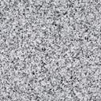
One Day Flooring (Example 1) – Broadcast Floor
Benefits
  Free of nonyl phenol, benzyl alcohol
  Low VOC/emissions / No odor
  Low temperature application (5ºC)
  High performance/durability
Primer – Ancamine® 2850
  Moisture vapor barrier
  Adhesion to damp/green concrete
  High mechanical strength
+ 3 hrs
Midcoat – Amicure® IC-221/IC-321
  Receiving Clear or Pigmented
  Flake, quartz, metallic
  Hides UV resistance of epoxy
Topcoat
+ 2 = 5 hrs
Basecoat
Topcoat - Amicure® IC-221/321/322
  High gloss or satin finish
  Impact resistance (> 160 in. lbs)
  QUV-A(500hrs) = < 3
  Taber abrasion (< 45 mg)
Primer
Concrete
+ 2 = 7 hrs

Slide 15

One Day Flooring (Example 2) – Thin Film Coating
Benefits
  Less Material (< 15 mils film build)
  Easy handling / long working time
  Low VOC/emissions / No odor
  Medium performance/durability
Primer – Anquamine® 287
  Long pot-life
  Penetrating into concrete
  Excellent adhesion to damp/green concrete
+ 2 hrs
Midcoat – Anquamine® 401/Ancarez® AR555
  Long pot-life
  Clear or pigmented thin film
  Lightly flaked
  Very good UV resistance
+ 2 = 4 hrs
Topcoat
Basecoat
Topcoat - Amicure® IC-221/321/322
  High gloss or satin finish
  Impact resistance (> 160 in. lbs)
  QUV-A(500hrs) = < 3
  Taber abrasion (< 45 mg)
Primer
Concrete
+ 2 = 6 hrs

Slide 16
Combining Epoxy and Polycarbamide Technologies Enables
Faster
Flooring job produced in a single day
Rapid return to service
Low Temperature cure
Better
  Excellent adhesion to concrete (dry & damp)
  Strong physical properties
  High abrasion and impact resistance
  Moisture tolerance
  Customizable gloss with UV stability
Safer
  Low to Zero VOC
  Free of nonyl phenol
  Waterborne epoxy
  Low emissions
  No Odor

Slide 17
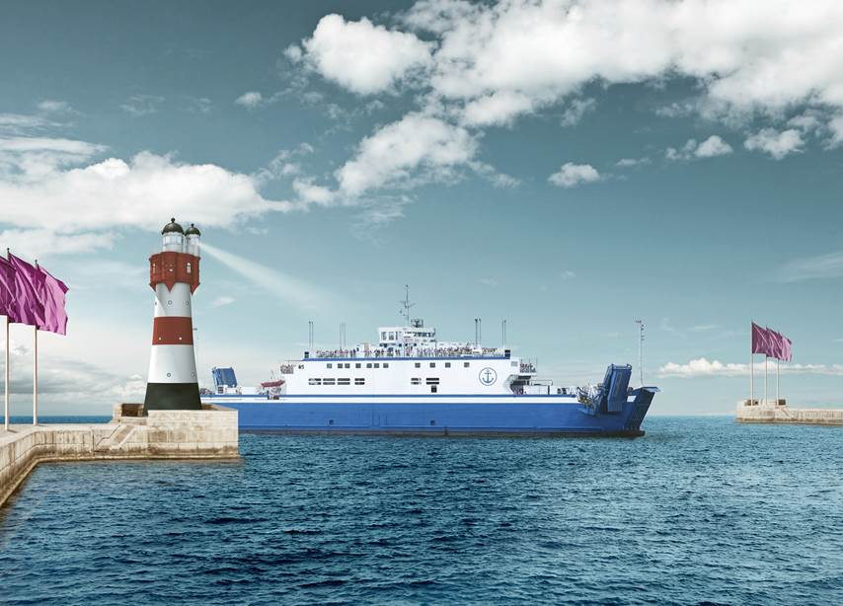
Acknowledgements
David Brown
Svetlana Ivanova
Ask the expert
Shafiq.fazel@evonik.com

